Slide 1
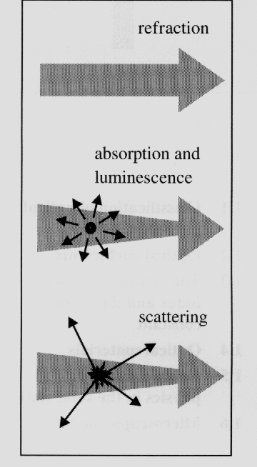
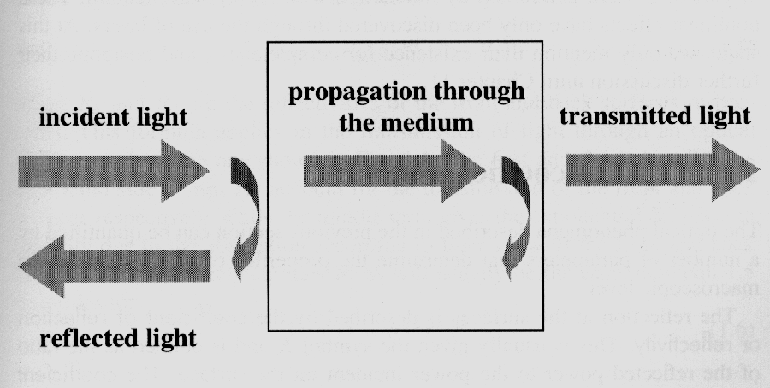
Chapter 1 Introduction
1.1 Classification of optical processes
Reflection
Propagation
Transmission
refractive index
n(ν) = c / v (ν)
Snell’s law
absorption
~ resonance
luminescence
~ spontaneous
emission
elastic and
Inelastic scattering
nonlinear-optics
Optical medium
Optical medium
Propagation

Slide 2
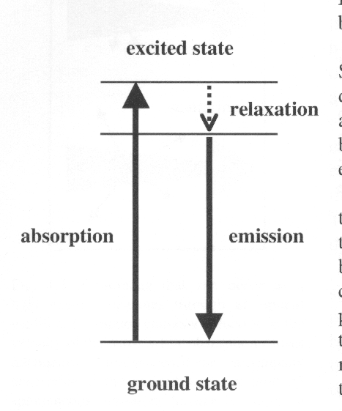




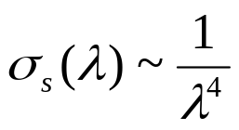
1.2 Optical coefficients
Luminescence
Coefficient of reflection or reflectivity (R):
R = reflected power / incident power
Transmission or transmissivity (T):
T = transmitted power / incident power
R + T = 1
Refractive index (n):
Absorption coefficient (α)
d I = - α d z* I (z);
Beer’s law:
α is strong function of frequency
The atom jumps to an excited state by absorption of a
Photon, then relaxes to an intermediate state, before re-
emitting a photon by spontaneous emission as it falls
To the ground state. The photon emitted has a smaller
energy than the absorbed photon. The reduction in the
Photon energy is called the Stokes shift.
Scattering
Variation of n of the medium on a length scale
smaller than the λ of the light
N: the number of scattering centres / V;
σ_{S:} scattering cross-section;
α = N σ_{S}
Rayleigh scattering :

Slide 3


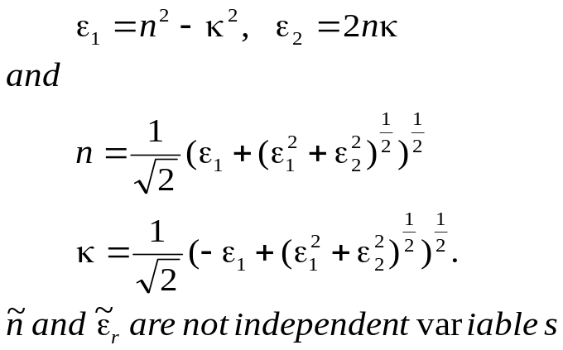
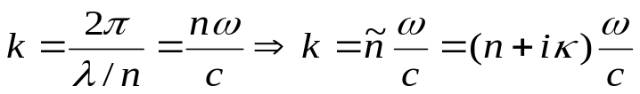
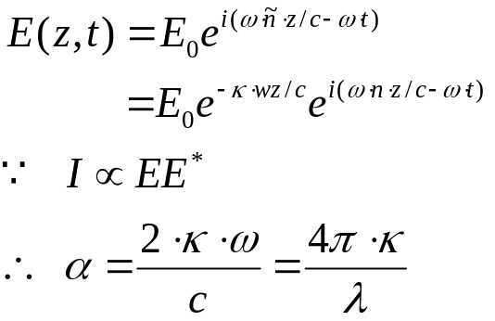
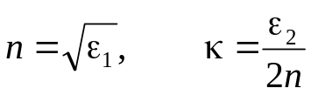
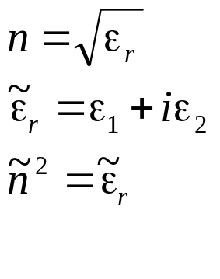
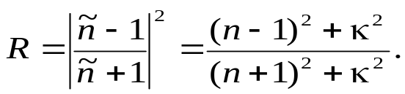
1.3 The complex refractive index and dielectric constant
Complex refractive index
κ: extinction coefficient
Where
Complex dielectric constant
The relationship between the real and imaginary
parts of two coefficients:
For weakly absorbing medium, κ is very small,
The reflectivity (normal incidence) :
In the transparent region of material :
is very small, κ and ε₂ are negligible, one may consider only the real parts of n and ε;
In the absorption region, one need to know
both the real and imaginary parts of n and ε.

Slide 4
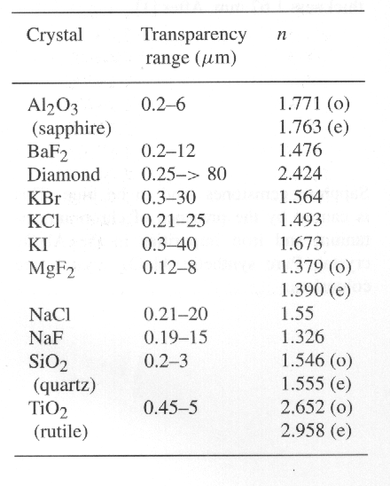
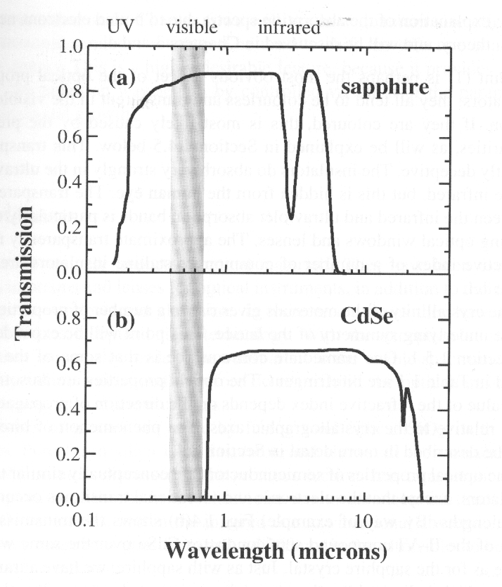
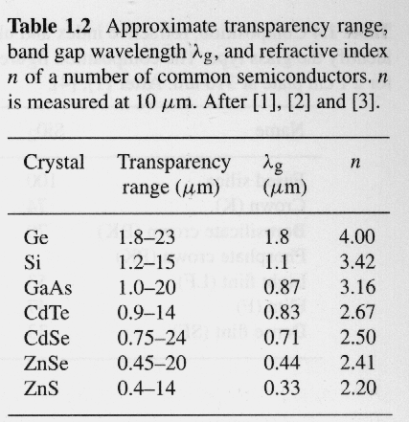
1.4 Optical materials
1.4.1 Crystalline insulators and semiconductors
Transparency range, the index
may be taken to be real with no
imaginary component
(approximately constant n=1.77)
R = 0.077, hence T =(1-R)²=0.85
Phonon absorption or lattice
absorption
Due to absorption by bound
electrons
Fundamental absorption edge,
is determined by the band gap.
The optical properties of semiconductors are similar to
those of insulators, expect that the electronic and phonic
transitions occur at longer wavelengths. Its transparency
range lies outside the visible spectrum, so it has a dark
Metallic appearance.

Slide 5
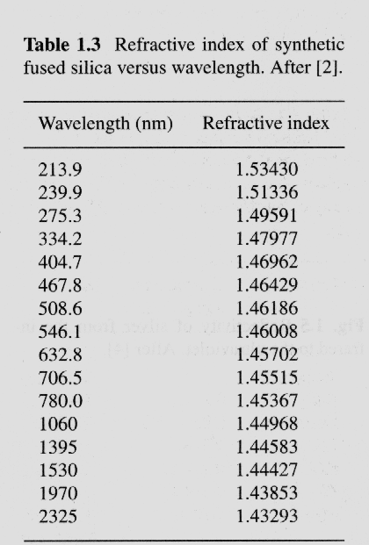
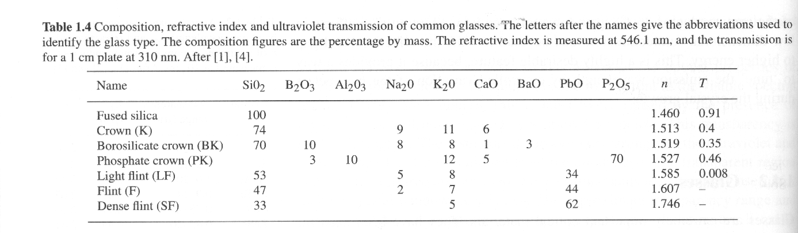
1.4 Optical materials
1.4.2 Glass
Most types of glasses are made of silica (SiO₂) with other chemicals. Insulator, all the characteristic features crystalline insulators, the trans range from around 200 nm to
beyond 2000 nm;
Small absorption and scattering losses; n changes by
less than 1% over the whole visible spectral region;
Chemicals are commonly added to silica during the fusion
process to alter the refractive index and transmission range;
Stained glass and colour glass filter are made by adding
semiconductors with gaps in visible spectral region.

Slide 6
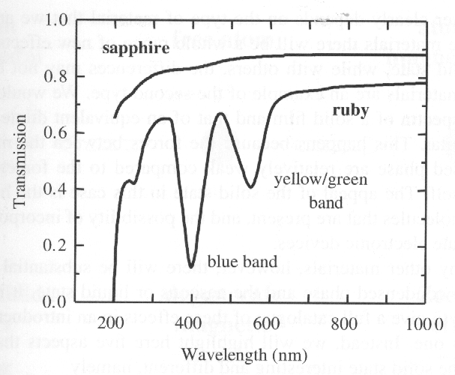
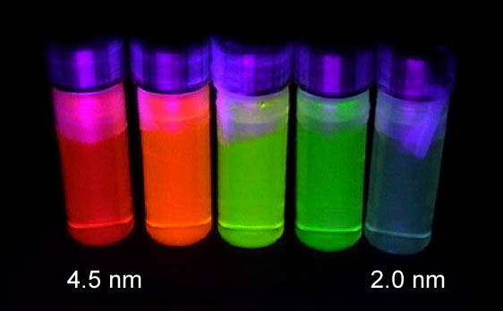
1.4 Optical materials
1.4.3 Doped glasses and insulators
Materials can take on new properties by controlled doping with optically active substance.
The principle of doping optically active atoms
into colourless hosts is employed extensively
in the crystals used for solid state lasers. A
typical example is the ruby crystal. Rubies
consist of Cr+3 ions doped into Al2O3. In
the natural crystals, the Cr+3 ions are present
as impurities, but in synthetic crystals, the
dopants are deliberately introduced in controlled
quantities during the crystal growth process.
Transmission spectrum of ruby (ruby Al₂O₃
With 0.05% Cr³⁺) compared to sapphire(pure
Al₂O₃). The thicknesses of the two crystals
were 6.1 mm and 3.0 mm, respectively
Diameter
CdSe Nanocrystals

Slide 7
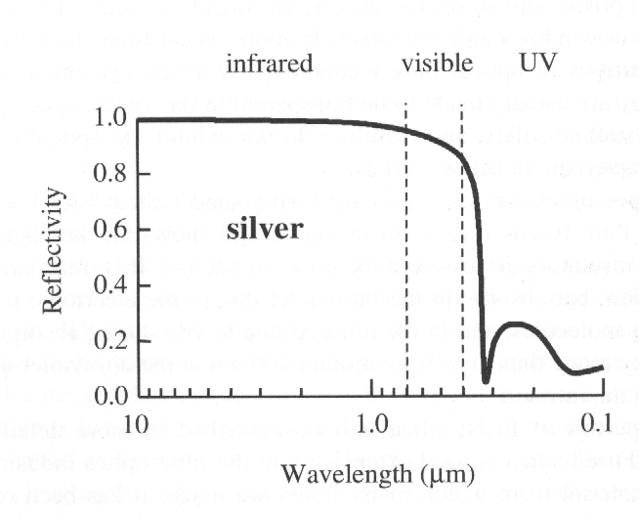
1.4 Optical materials
1.4.4 Metals
Reflect infrared and visible, but transmit
ultraviolet (ultraviolet transmission of metals);
High reflectivity is caused by the interaction of the light with the free electrons in metal;
There is a characteristic cut-off frequency called the plasma frequency.
Reflectivity of silver from the infrared to the
ultraviolet

Slide 8
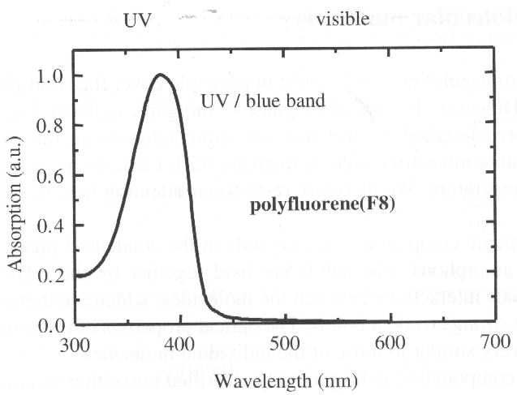
1.4 Optical materials
1.4.5 Molecular (large organic molecules) Materials
The molecular materials are held together by the weak van de Waals bonds, whereas the molecules are held together by strong covalent bonds. The optical properties of materials are similar to those of the individual molecules;
Saturated compounds: compounds which do not contain any free valence (all the electrons are tightly held in their bonds), and are transparent in the visible, absorb in the infrared and ultraviolet (insulator crystals);
Conjugated molecules (bezene C₆H₆): The electrons form large delocalized orbitals called π orbitals which spread out across the whole molecule, therefore are less tightly bound than the electrons in saturated molecules. The molecules with visible absorption also tend to emit strongly at visible frequencies (semiconductors);
Absorption spectrum of the polyfluorene-based
polymers F8. Conjugated polymers such as F8
luminesce strongly When electrons are promoted
into the excited states of the molecule. The lumi-
nescence is Stokes shifted to lower energy compared
to absorption, and typically occurs in the middle of
the visible spectral region. The emission wavelength
can be tuned by small alternation to the chemical
structure of the molecular unit within the polymers.
The property has been used to develop organic light
emitting devices to cover the full visible spectral region.

Slide 9
1.5 Characteristic optical physics in the condensed matter
What the difference is between condensed matter and atomic or molecular optical physics?
1.5.1 Crystal symmetry
* long range translational order
Electronic bands, delocalized states, … …
* point group symmetry
Neumann’s principle
The measurable property point group symmetry
Any macroscopic physical property must have at least the symmetry of the
crystal structure
Optical anisotropy: birefringence, nonlinear optical coefficient … …
Crystal symmetry
Electronic bands
Vibronic bands
The density of states
Delocalized states and collective excitations

Slide 10
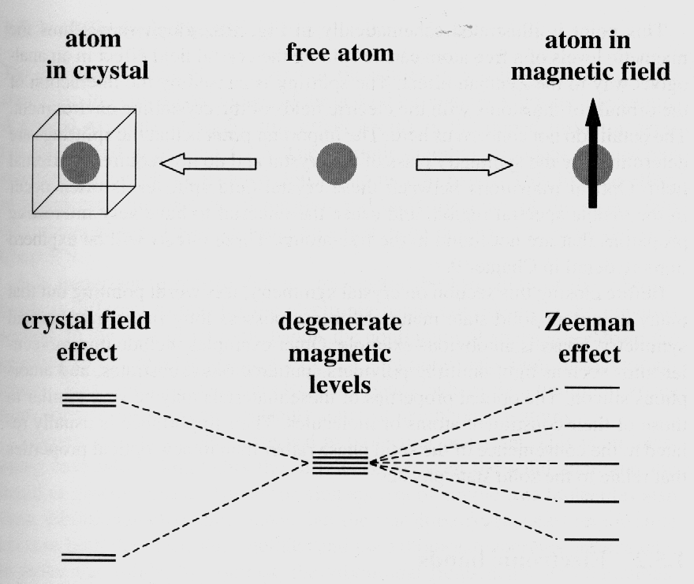
1.5 Characteristic optical physics in the condensed matter
1.5.1 Crystal symmetry
Optical anisotropy:
Lifting of degeneracies:
Degeneracy can be lifted by reduction of the symmetry
Splitting of the energy levels of a free atom
by the crystal field effect determined by the symmetry class of the crystal. The splitting
Is caused by the interaction of the orbitals of
The atoms with the electric fields of the cry-
stalline environment. Optical transition between these crystal-field spilt levels ofen occur in the visible region, and cause the material to have every interesting properties that are found in the free atoms.

Slide 11
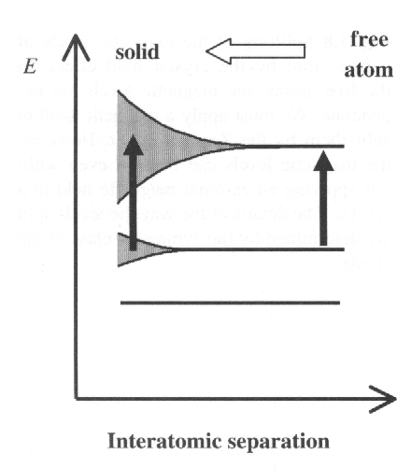

1.5 Characteristic optical physics in the condensed matter
1.5.2 Electronic bands
The electronic states within the bands are
delocalized and possess the translational
invariance of the crystal. Bloch’s theorem
states that the wave functions:
where u_{k}(r ) is a function that has the periodicity of the lattice. Each electronic band has a different envelope function u_{k}(r )
As the atoms are brought closer together to form the solid, their outer orbitals begin to overlap with each other. These overlapping orbitals interact strongly, and broad bands are formed.
1.5.3 Vibronic bands
The band arises from the coupling of discrete electronic state to a continuous spectrum of vibrational mode. This contrast with the electronic band that arises
from interaction between electronic states of neighbouring atoms.

Slide 12
1.5 Characteristic optical physics in the condensed matter
1.5.4 The density of states
This is defined as:
Number of states in the range E → ( E + d E) = g (E) d E.
g(E) is work out in practice:
g(E) = g(k)·dk / dE
This can be evaluated from knowledge of the E-k relationship for electrons or phonons.
1.5.5 Delocalized states and collective excitations
phonon: the collective excitation of lattice vibration;
exciton: formed from delocalized electrons and holes in semiconductors;
plasmon: formed from free electrons in metals and doped semiconductors;
… …
many optical effects related to these … …
1.5.6 Microscopic models
Classical : Treat both the medium and the light according to classical physics;
Semiclassical: apply quantum mechanics to atoms, treat light as a classical
electromagnetic wave;
Fully quantum: both atoms and light are treated quantum mechanically.

Slide 13


Exercises:
The complex refractive index of germanium at
400 nm is given by . Calculate for germanium at 400 nm: (a) the phase velocity of light, (b) the absorption coefficient, and ( c) the
reflectivity.
Show that the optical density (O.D.) of a sample is related to its transmission T and reflectively R through:
Hence explain how you would determine the optical density by making two transmission measurements, one at wavelength λ where the material absorbs, and the other at a wavelength λ’ where the material is transparent.

